Slide 1
Principal Component Analysis
Marlabs

Slide 2
PCA
It is an unsupervised statistical technique used to examine the interrelations among a set of variables in order to identify the underlying structure of those variables.
It is also known sometimes as a general factor analysis.

Slide 3
PCA
Where regression determines a line of best fit to a data set, factor analysis determines several orthogonal lines of best fit to the data set.
Orthogonal means “at right angles”.
Actually the lines are perpendicular to each other in n-dimensional space.
N-Dimensional Space is the variable sample space.
There are as many dimensions as there are variables, so in a data set with 4 variables, the sample space is 4-dimensional.

Slide 4
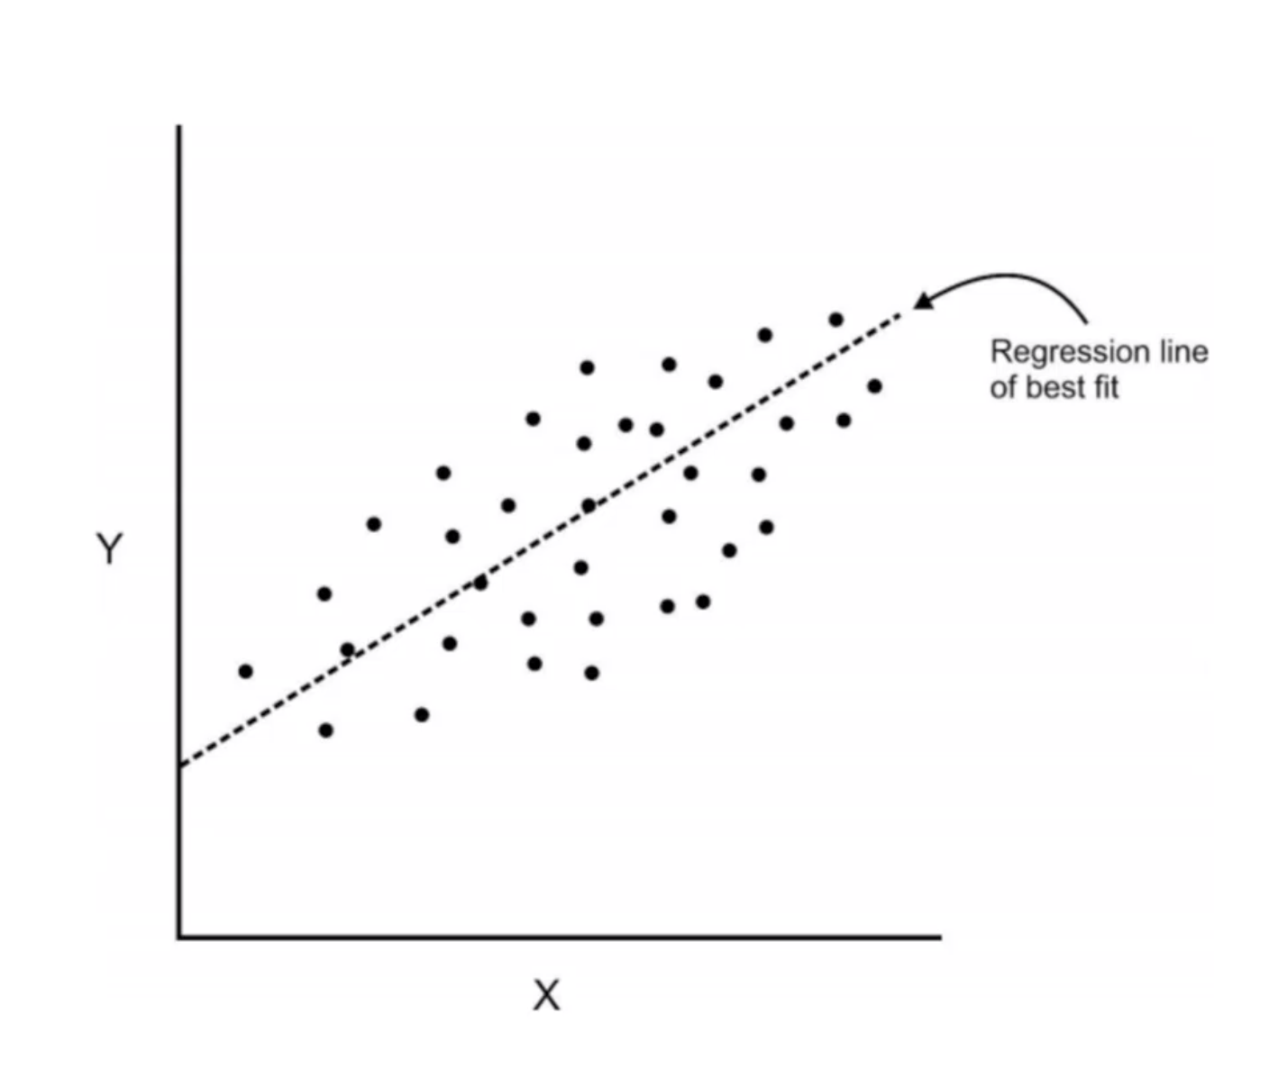
PCA
Here we have some data plotted along two features, x and y.

Slide 5
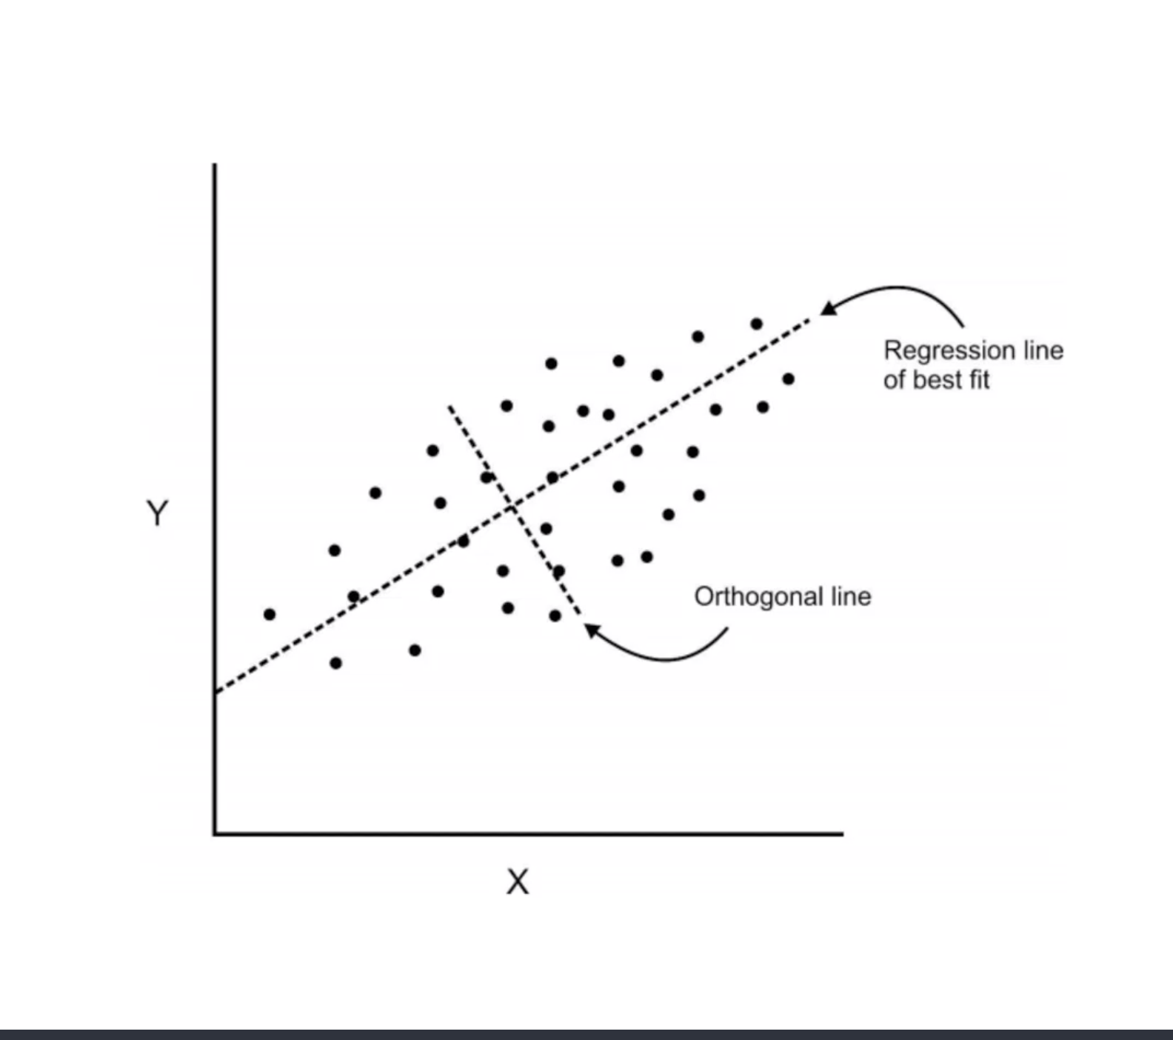
PCA
We can add an orthogonal line.

Slide 6
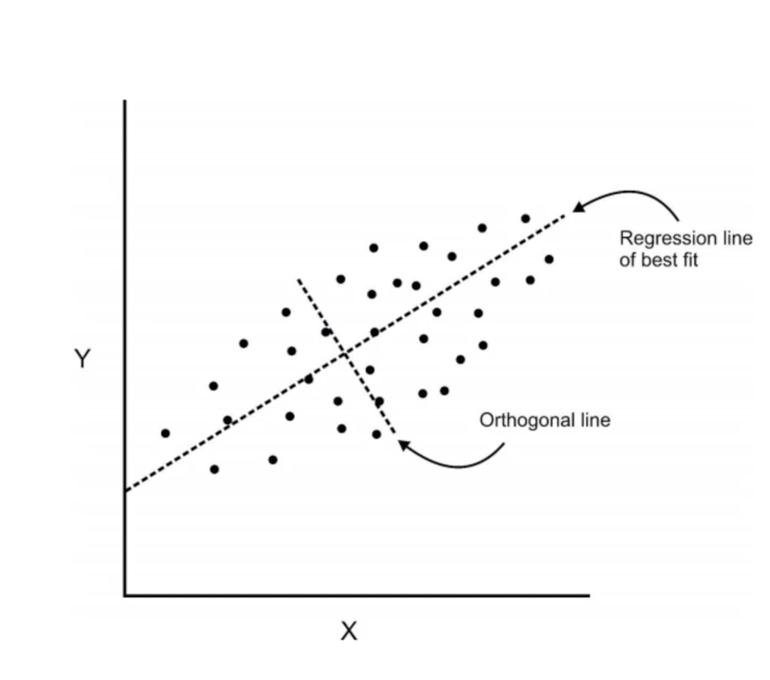
PCA
Components are a linear transformation that chooses a variable system for the data sets such that the greatest variance of the data set comes to lie on the first axis.

Slide 7
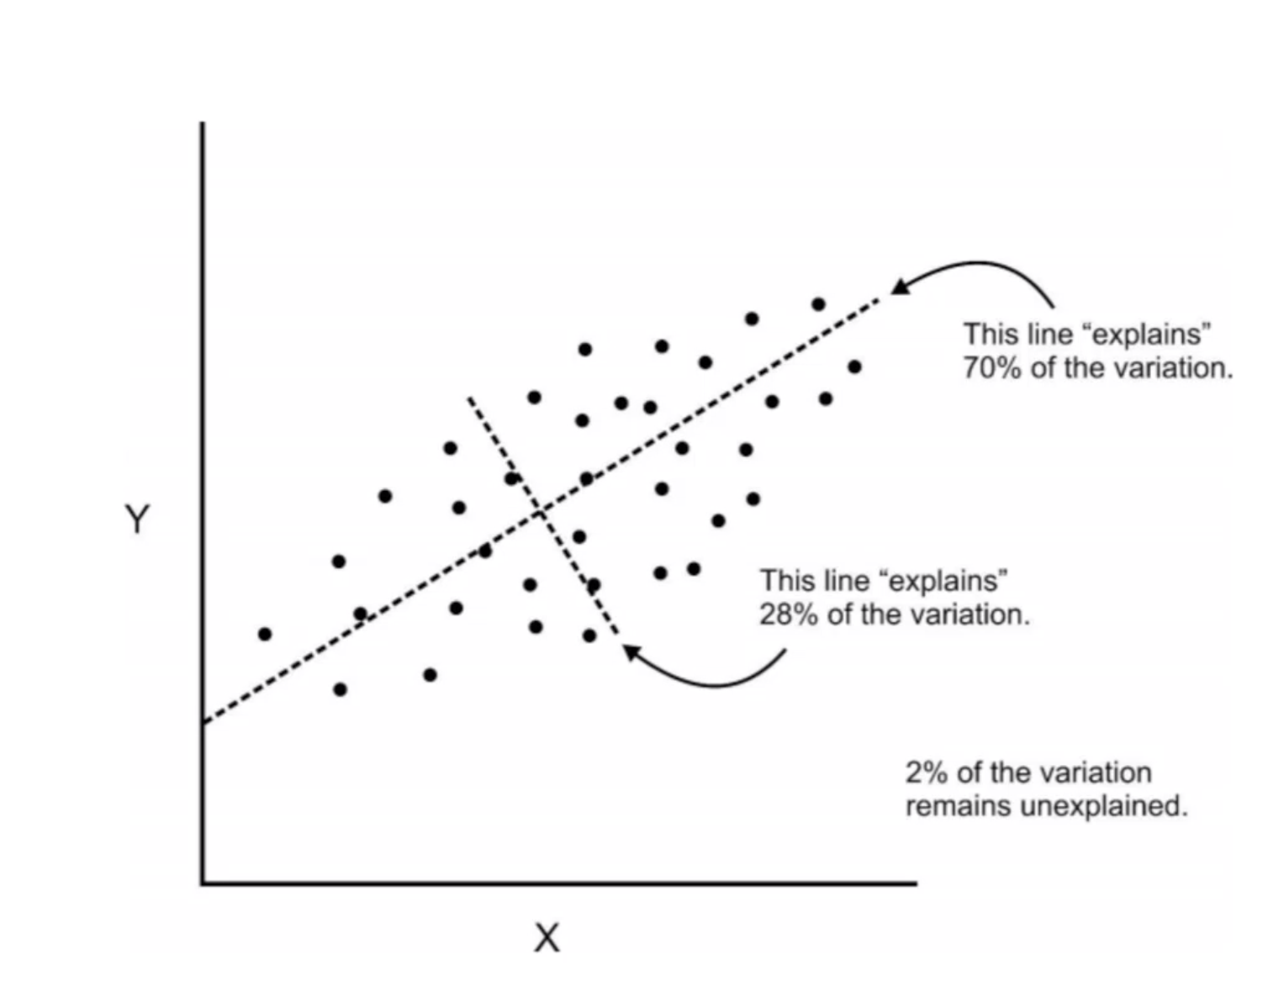
PCA
The second greatest variance on the second axis, and so on…
This process allows us to reduce the number of variables used in an analysis.

Slide 8
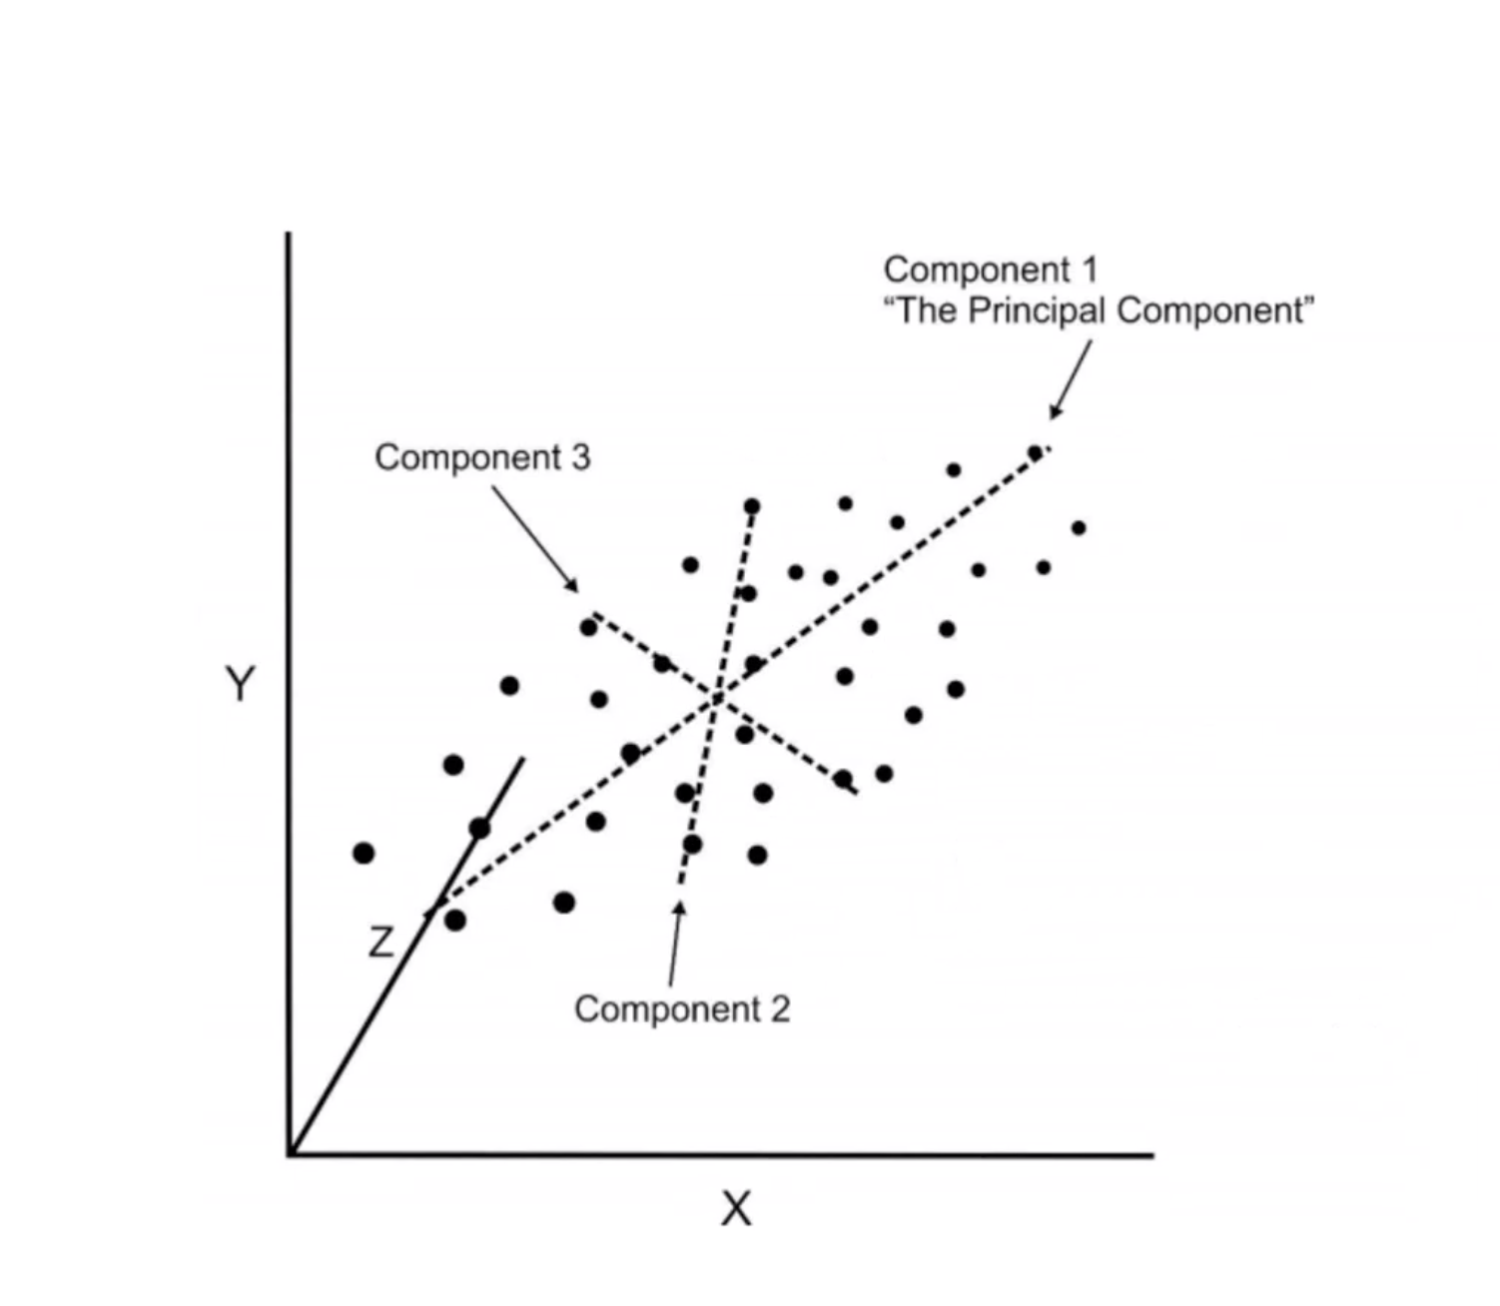
PCA
We can continue this analysis into higher dimensions.

Slide 9
PCA
If we use this techniques on a data set with a large number of variables, we can compress the amount of explained variation to just a few components.
The most challenging part of PCA is interpreting the components.
We need to standardize our data by some scale before we use PCA.
PCA is used usually for analysis of data and not a fully deployable model.

Slide 10
PCA Procedure
Standardize the data.
Obtain the Eigenvectors and Eigenvalues from the covariance matrix or correlation matrix, or perform Singular Vector Decomposition.
Sort eigenvalues in descending order and choose the k eigenvectors that correspond to the k largest eigenvalues where k is the number of dimensions of the new feature subspace.
Construct the projection matrix W from the selected k eigenvectors.
Transform the original dataset X via W to obtain a k-dimensional feature subspace Y.

Slide 11
Eigenvectors & Eigenvalues
The eigenvectors (principal components) determine the directions of the new feature space, and the eigenvalues determine their magnitude. In other words, the eigenvalues explain the variance of the data along the new feature axes.

Slide 12
Dimension Reduction VS. Feature Selection
PCA is a dimensionality reduction algorithm where new features are created which represents the original feature dimensions in a lower dimension with a little loss of the total information.
Feature selection keeps the features intact and chooses n best features among them, removing the redundant and co-linear features.

Slide 13
Techniques for Dimension Reduction
Missing values
Low variance
Decision tree (built-in feature importance)
Random forest (built-in feature importance)
High correlation
Backward feature elimination
Factor analysis
Principal Component Analysis

